Slide 1
Capstone: Emissions by Country Over Time
By: Scott Manusov
For: Coding Temple - Data

Slide 2
Hypothesis
Hypothesis 1: Most emissions come from the US and 2nd most from China, with India relatively high, other first world countries are a little lower, 3rd world countries are the least
Hypothesis 2: US, China, and first world countries have reduced their share of emissions over time

Slide 3
Methodologies
First explored 2 different data sets from Our World in Data covering Co2 emissions
Then combined them into a single data set for ease of working
Next created lists (tibbles) of the highest and lowest by different metrics
After noticing that lots of the highs were comprised of groups instead of countries created groups that excluded them
Next graphed on what I found (dug in when interesting trends were found)

Slide 4
Metrics and Definitions
I used 2 different ways to measure Carbon Dioxide emissions:
Measure 1 involved using emissions per capita.
This was measured in actual emitted Carbon Dioxide
This accounts for a countries’ population and essentially looks at how much each member of a country pollutes.
If a country increases its population it is allowed to pollute more (by this metric)
Measure 2 involved using cumulative share of emissions
This was measured as a percentage of all emissions each year.
This is a better measure for duration studies (not as valuable to compare different sized countries)

Slide 5
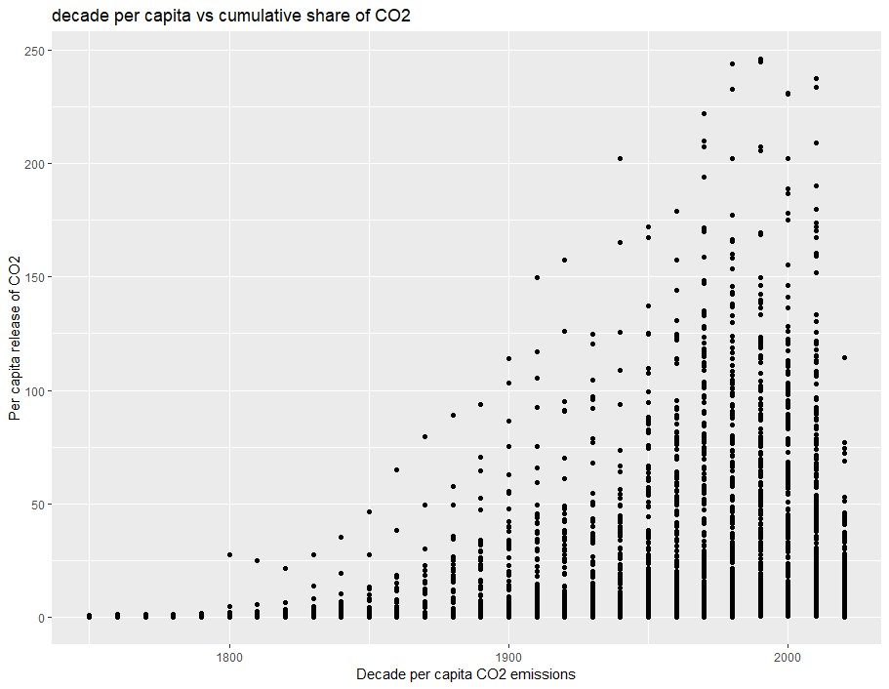
Exploratory Findings: all emissions
Worldwide emissions increase over time.
1970’s Emissions largely slow down
and started levelling off
No new gains seen from recent agreements
Most recent decade isn’t completed so hard to determine changes off of partial decade results.

Slide 6
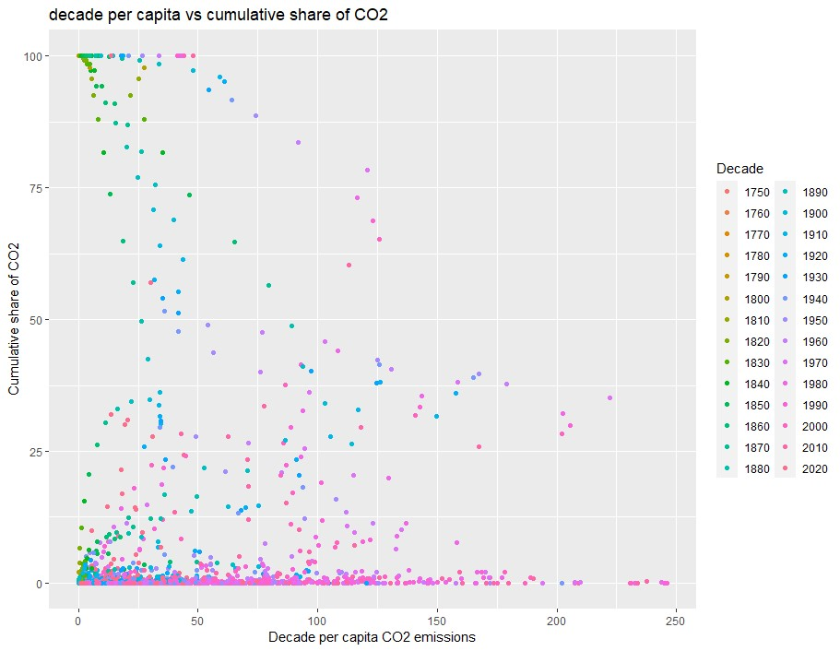
Exploratory Findings: Share vs Per capita emissions
No strong trend between share and per capita
emissions
Higher emissions tend to happen in later decades
There is a spike in per capita emissions at:
45% share, and weak mode at about 70%
The 70% likely comes from groups of nations

Slide 7
Hypothesis 1 Findings
Hypothesis: Most emissions come from the US and 2nd most from China, with India relatively high, other first world countries are a little lower, 3rd world countries are the least.

Slide 8
Who are the top countries and how do we define them.
The top countries are all countries with high GDP, most of which have relatively large populations.
For this one I used share of emissions averaged over the the entirety of their reporting, I did review the per capita as well, and small wealthy nations made up the list (their small population gave them little room to offset the emissions). I liked share of emissions for top countries as the countries have the most impact on worldwide emissions and can do the most as a country to fix it.
I excluded groups that were collections of countries such as wealthy nations, North American nations, European union, I still kept the United Kingdom, as they tend to have a very unified government (and a population smaller than several countries).
Summed up the Carbon dioxide the emitted each year

Slide 9
Who are the bottom countries and how do we define them.
The bottom countries are all countries with low GDP and most of which are in Africa.
For this one I used per capita, I did review the share as well, and small island nations made up most of the list (their small population gave them a smaller impact).
I liked share of emissions for bottom countries as the countries people are producing the least emissions, they may have strategies that other countries could use.
Averaged the sum of their emissions over the years.

Slide 10
Top/Bottom Emitters
Rank | Top by per capita (CO2 tons per year) | Top by Share (Average %) | Bottom by per capita (CO2 tons per year) | Bottom by per capita (CO2 per year)
1 | Sint Maarten (14.80) | United Kingdom (43.1) | Burundi (0.003) | Tuvalu (1.4E-6)
2 | Curacao (5.05) | United States (21.4) | Sierra Leone (0.004) | Niue (1.1E-5)
3 | Qatar (4.57) | Germany (9.0) | Ethiopia (0.005) | Saint Helena (1.4E-5)
4 | UAE (2.88) | France (5.5) | Rwanda (0.006) | Wallis and Futuna (2.9E-5)
5 | Kuwait (2.85) | China (3.8) | C. African Rep (0.006) | Montserrat (5.8E-5)
* India was about top 64th/221 countries using Share and excluding the groups of countries

Slide 11
Hypothesis 1 Summary
UK has the highest share of emissions in part because of emitting and reporting emissions before other countries
After the UK it is the US and then Europe
Followed by China
India is far lower in share of emissions
3rd world countries are the lowest emitters
African nations also make up most of the list of lowest emitters.

Slide 12
Hypothesis 2 Findings
Hypothesis: US, China, and first world countries have reduced their share of emissions over time

Slide 13
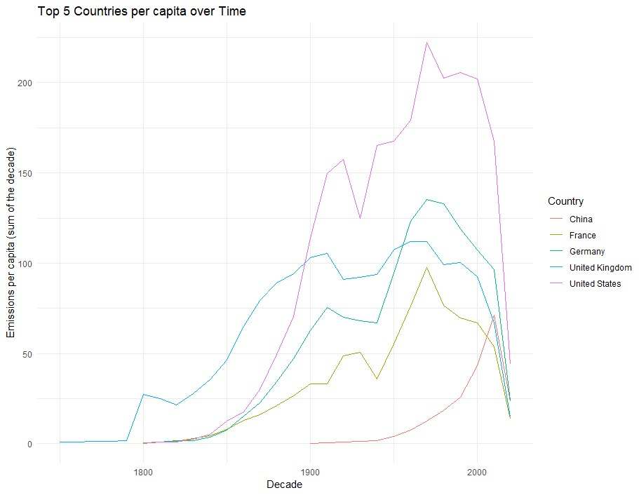
Emissions per capita by country over decades
Emissions by person in each of the top countries
Increased through the 1970’s
European countries started reducing then
US flattened out
China has kept increasing emissions per capita
UK started as the highest producer,
but has been dropping
US took the lead in the 1900’s and has held it since
The most recent decade US still leads in emissions

Slide 14
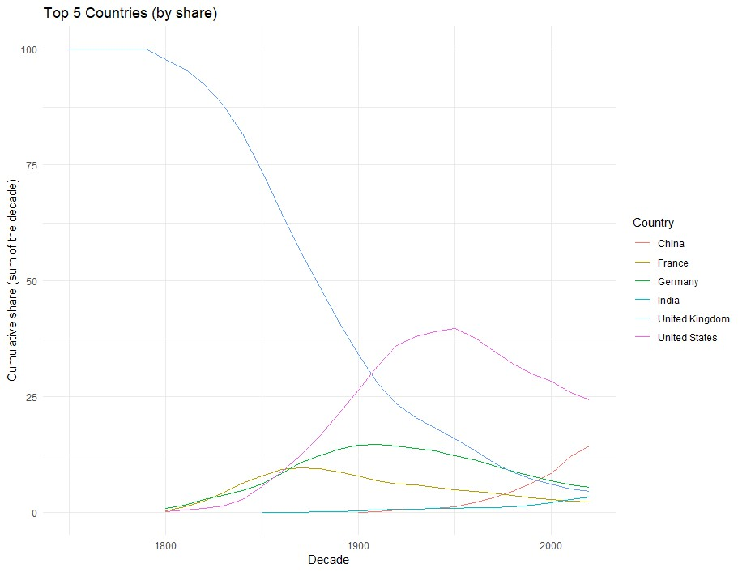
Emission share by country over decades
As the rest of the world modernizes
the largest emitters have managed to lower their share,
despite increasing their per capita
Only China of the largest emitters is increasing
India is also increasing (although not a top emitter,
but may soon be).

Slide 15
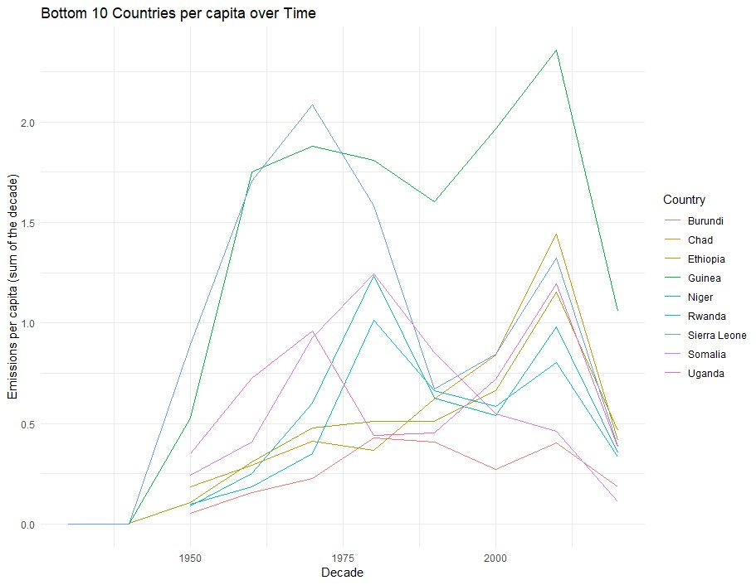
Digging Deeper, bottom country trends: Emissions per Capita by Country Over Decades
These countries slow increase per capita
Lots of change with spikes at 1980 and 2010

Slide 16
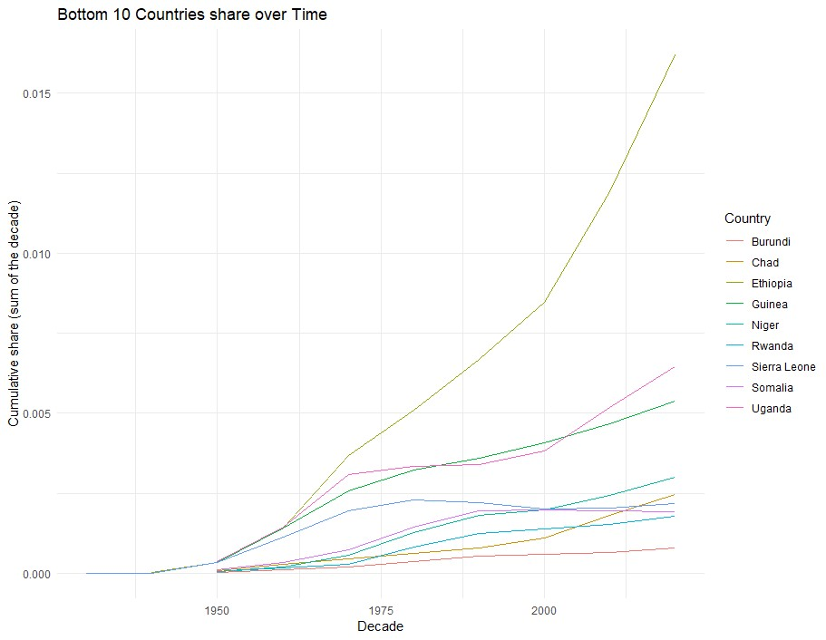
Emissions by Share of Countries Over Decades
Countries are all increasing their share
despite little change in per capita
Most of their increases are coming with
Dramatic population growth
Different countries are growing at different rates
Ethiopia is growing much faster than the rest

Slide 17
Hypothesis 2 Summary
US and most of the first world countries that make up the top emitters have reduced their emissions over time both by share and by per capita in recent decades
China has continued to increase their emissions (both by per capita and by share)
Countries with the least emissions are rapidly increasing their share of emissions mostly with population increases
The gap between the highest and lowest emitting countries while vast is shrinking.

